Slide 1
Chatbot for Sales Consulting
AI01 – 01

Slide 2
Unit 1. Challenges and Objectives
UNIT
01

Slide 3


Challenges
1.
Challenges and Objectives
01
In today's highly competitive business landscape, companies must identify and leverage their Unique Selling Propositions (USP) to enhance customer service and boost sales efficiency.
Companies are also facing a huge challenge in managing high volumes of customer interactions, while also needing to optimize their sales processes to increase revenue.
Sales chatbots, with their continuous operation and ability to handle multiple interactions simultaneously, provide an effective solution to these issues.

Slide 4

Objectives
1.
Challenges and Objectives
UNIT
01
The immediate objectives are:
To understand foundational knowledge about artificial intelligence and advanced Large Language Models (LLM) with ChatGPT, as a basis for research and analysis
Studying interactivity and accuracy in providing information
Testing and applying methods to optimize the effectiveness of language models in real-world environments.

Slide 5
Unit 2. Project Implementation
UNIT
02

Slide 6
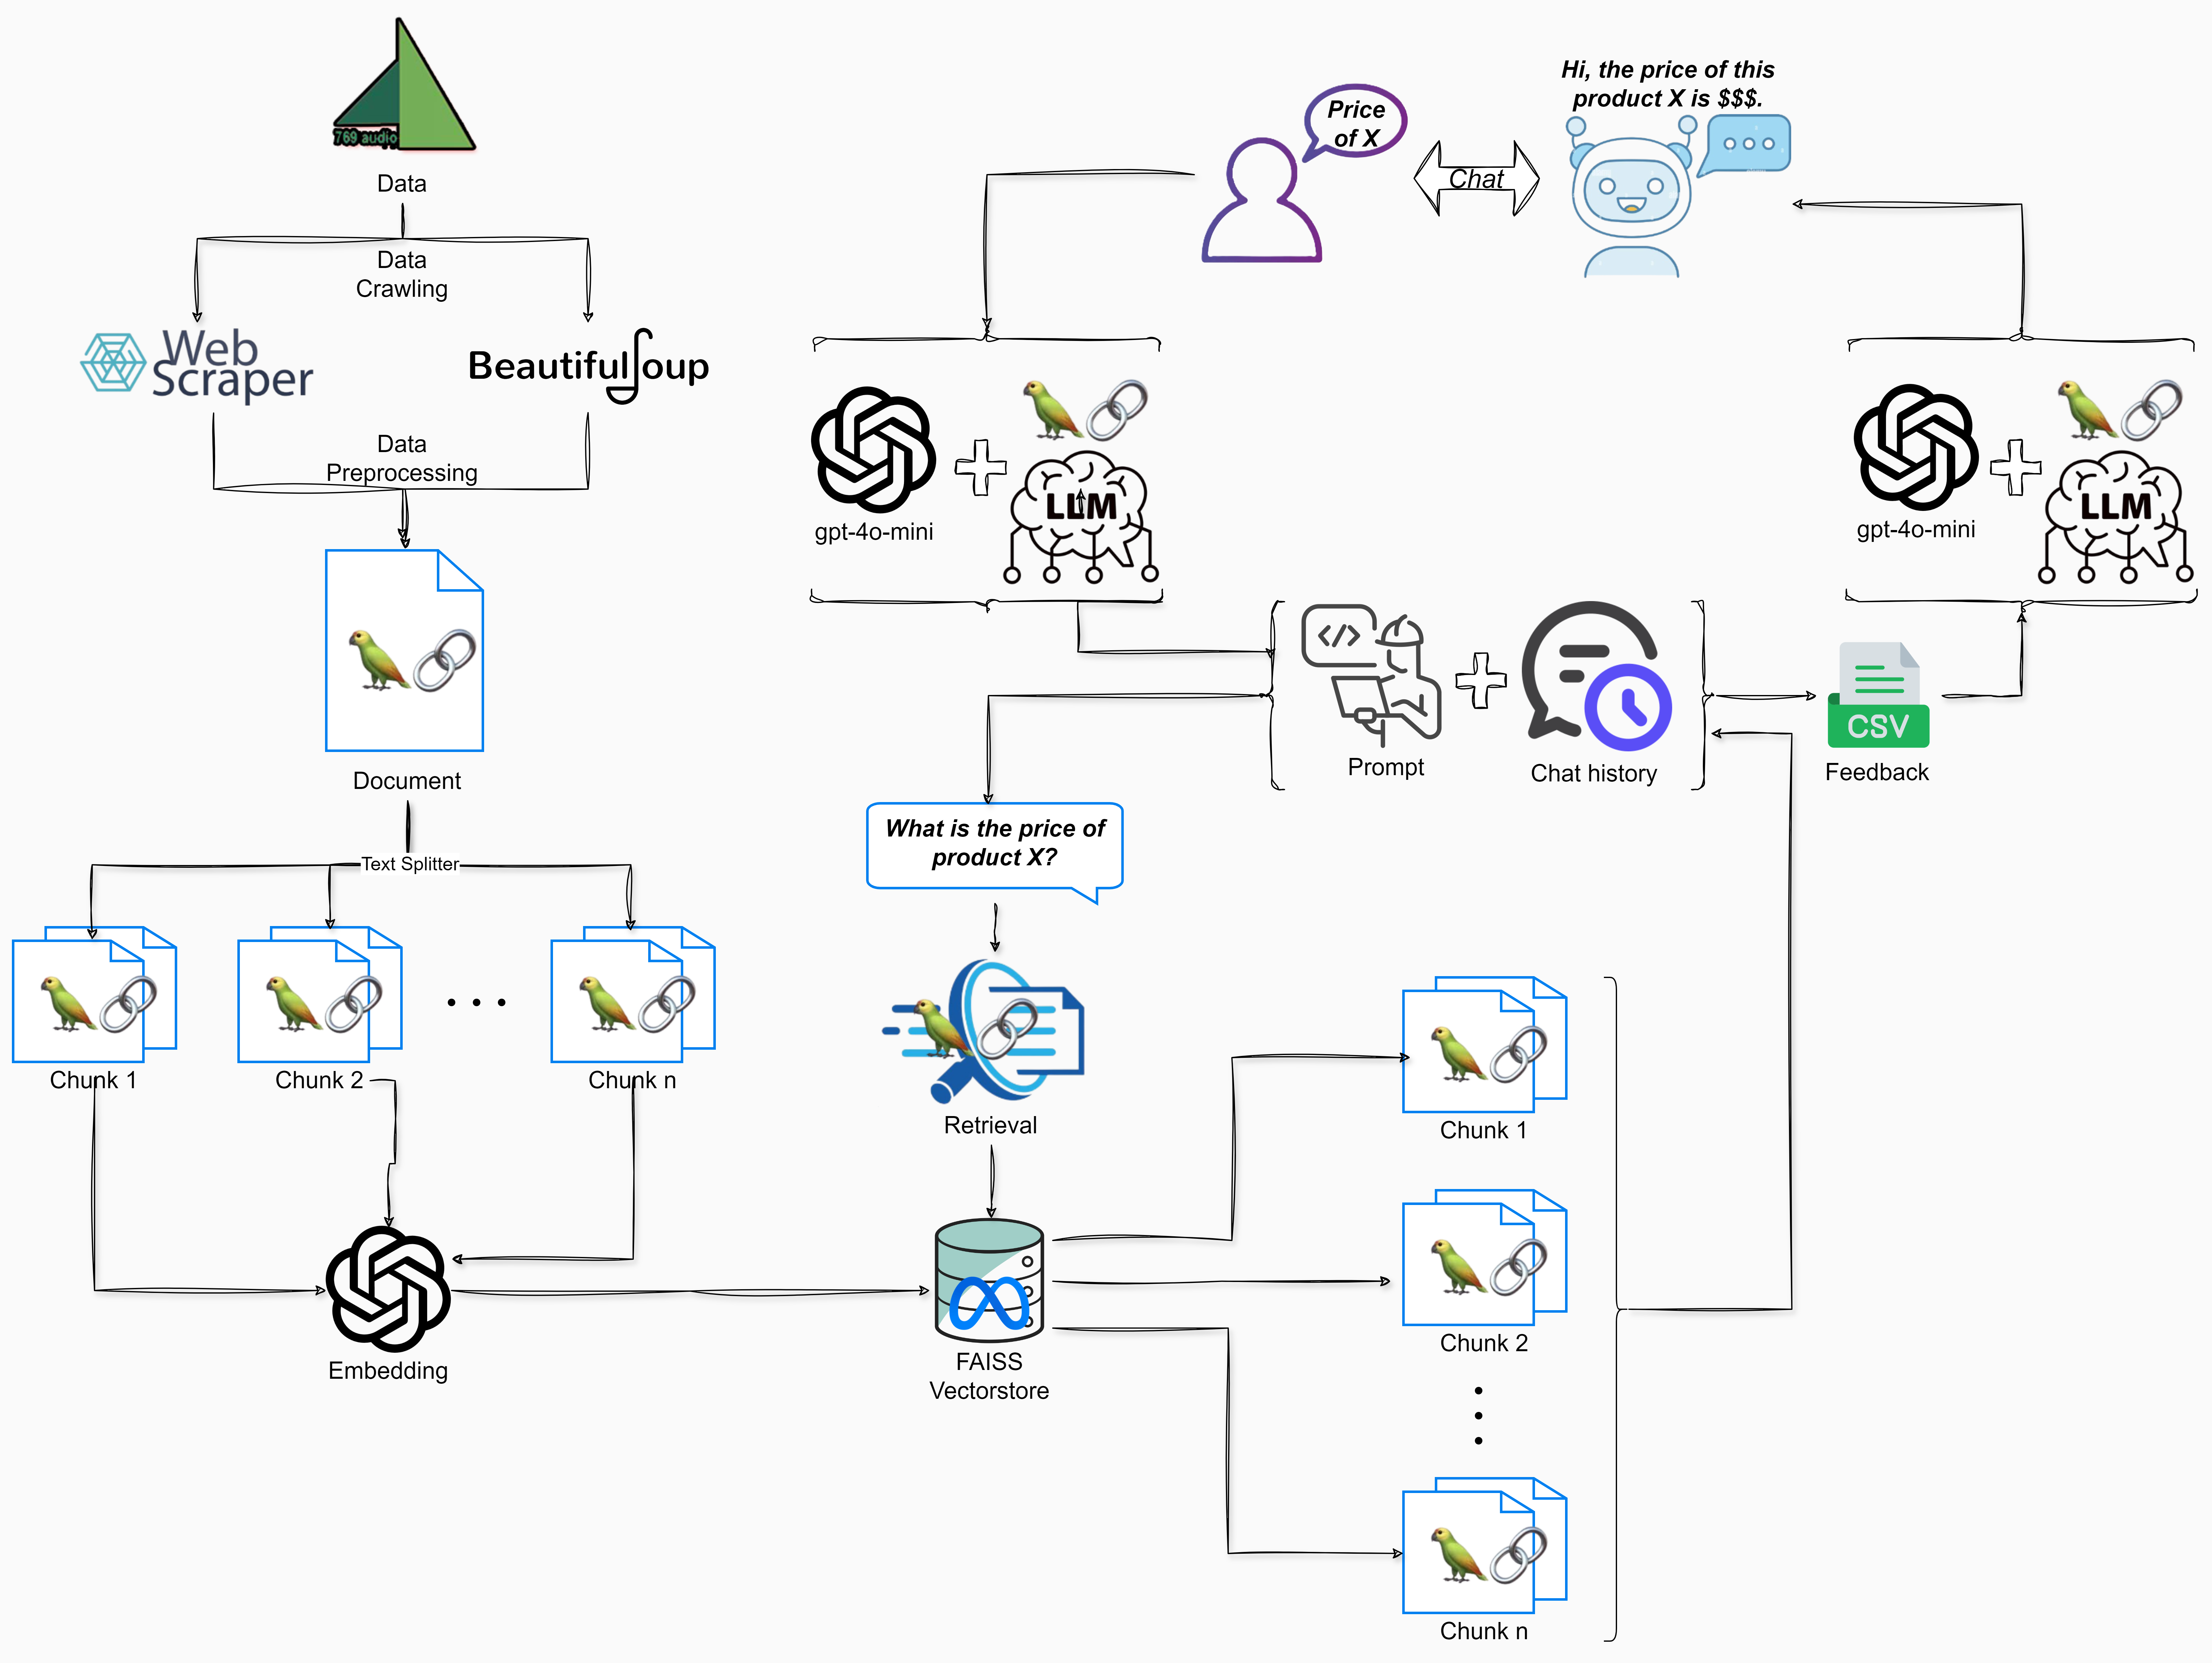
2.1
System Diagram

Slide 7
2.2
Training Methods
02
UNIT
Data Preprocessing:
Objective: Standardize and clean specific columns in dataset.
Methodology: Handle currency formats, normalize item status, and improve the readability of text columns.
def clean_currency(price):
def convert_status(status):
def format_text(text):

Slide 8
2.2
Training Methods
02
UNIT
Data Splitting: Determine optimal chunk size
Average characters per sentence in “Giới thiệu” (Introduction) column: 63.251697494731914
Average characters per sentence in “Chi tiết” (Detailed content) column: 67.33951225097321
text_splitter = RecursiveCharacterTextSplitter(
chunk_size=65,
chunk_overlap=2
)

Slide 9
2.2
Training Methods
02
UNIT
Data Splitting:
chunk_size=500
chunk_size=65
text_chunks = text_splitter.split_documents(data)
print(text_chunks[0].page_content)
Tên: Đầu CD Denon QS 10 II
link sản phẩm: https://769audio.vn/san-pham/1355/dau-cd-denon-qs-10-ii.html
Giá: 14500000
Link ảnh: thumb/400_400/2/upload/product/_271894290115.jpg
Tình trạng: 1
Giới thiệu: Giới thiệu sản phẩm Nhà phân phối 769 audio giới thiệu đến quý khách đầu denon qs10 ii, xuất xứ nhật bản, bảo hành 01 tháng, hàng đã qua sử dụng, còn mới 95%
Chi tiết: Chi tiết sản phẩm Mô tả Đầu cd denon dcd qs10ii đẹp xuất sắc Xuất xứ: japan, bảo hành 1 tháng
Tên: Đầu CD Denon QS 10 II

Slide 10
2.2
Training Methods
02
UNIT
VectorStore:
Create a search index based on FAISS (Facebook AI Similarity Search).
Embedding: OpenAIEmbeddings
from langchain_openai import OpenAIEmbeddings
embeddings = OpenAIEmbeddings()
docsearch = FAISS.from_documents(texts, embeddings)

Slide 11



2.2
Training Methods
02
UNIT
Retrieval
Similarity
This is a default search type, generally suitable for most applications requiring semantic understanding, and by default returning k = 4 most related documents.
In this project, we mainly focus on two search types
Similarity
Similarity score threshold
However, responses sometimes do not cover all product attributes and the retriever only collects similar chunks to the query, leading to wrong responses.
Similarity score threshold
This search type sets a threshold for the similarity scores, enhancing output documents, and maintaining a high quality of results.
retriever = docsearch.as_retriever(
search_type="similarity_score_threshold",
search_kwargs={
"score_threshold": 0.3,
"k": 15
}
)
=> In our ChatBot’s third version, we summarize rows of chunks and collect data rows from the summarized rows.

Slide 12
2.2
Training Methods
02
UNIT
Retrieval
# Query
query = """
Dạ, Chào anh chị, em đang quan tâm Loa JBL Control 25, Gía bán bên mình loa này sao anh chị
"""
# Retrieve initial chunks
initial_docs = retriever.invoke(query)
print("Page content:", initial_docs[0].page_content)
print("Row:", initial_docs[0].metadata["row"])
Page content: Loa jbl control 25 là một dòng loa treo tường sản xuất bởi hãng jbl...
Row: 667

Slide 13
2.2
Training Methods
02
UNIT
Retrieval
def retrieve_and_filter_chunks(row_numbers, data, excluded_columns=["Giới thiệu", "Chi tiết"]):
filtered_docs = retrieve_and_filter_chunks(row_numbers, data)
filtered_docs.extend(initial_docs)
for doc in filtered_docs:
if doc.metadata["row"] == 667 or doc.metadata["row"] == 658:
print(doc.metadata["row"], doc.page_content)

Slide 14
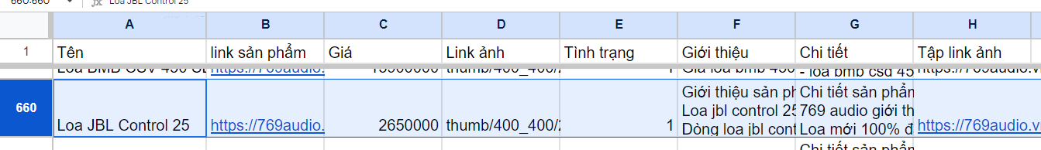
2.2
Training Methods
02
UNIT
Retrieval
Row: 658 - Loa JBL Control 25
Row: 658 - https://769audio.vn/san-pham/312/loa-jbl-control-25-chinh-hang.html
Row: 658 - 2650000.0
Row: 658 - thumb/400_400/2/upload/product/664225935743.jpg
Row: 658 - 1.0
Row: 658 - https://769audio.vn/upload/images/jbl%20control(2)...
Row: 667 - Loa jbl control 25 là một dòng loa treo tường sản xuất bởi hãng jbl...

Slide 15
2.2
Training Methods
02
UNIT
Retrieval
One trade-off for this is chunk expansion since we must collect more chunks from the database beside the vector store. Fortunately, there are not many additional chunks as they are just brief product information like name, price, status, etc.
Total number of letters in Initial docs: 10661
Total number of letters in Filtered docs: 12250

Slide 16
2.2
Training Methods
02
UNIT
Response Generation
Prompt Engineering:
premise = """
Giả sử bạn là một chuyên gia về thiết bị điện tử âm nhạc. Bạn đang làm việc tại 769audio, một trong ba nhà phân phối thiết bị âm nhạc hàng đầu tại TP.HCM. Bạn sắp tư vấn cho một khách hàng về phương pháp bán hàng phù hợp nhất để bán hàng cho họ, dựa trên thông tin được cung cấp.
...(more requirements)
"""

Slide 17
2.2
Training Methods
02
UNIT
Response Generation
Rephrase:
contextualize_q_system_prompt formulates them into more semantic and grammatical queries
You: 201 seri 4 nhieu vay chi
Contextualized Prompt: Bạn có thể cho tôi biết thêm về 201 seri 4 mà bạn đang đề cập đến không?

Slide 18
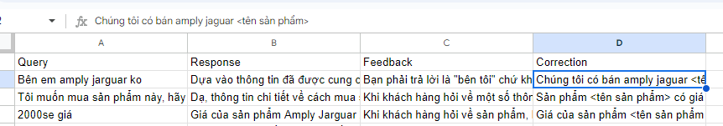
2.2
Training Methods
02
UNIT
Response Generation
Feedback:
A basic form of Reinforcement Learning to help the bot adapt and learn the response format that actual customers expect

Slide 19
2.2
Training Methods
02
UNIT
Response Generation
Response:
For LangChain LLM, we utilized gpt-4o-mini, for quick responses, cost efficiency.
To ensure the highest accuracy in our bot's responses, we set the temperature=0, optimizing predictivity.
llm = ChatOpenAI(model='gpt-4o-mini', temperature=0)

Slide 20
Unit 3. Testing and Improvements
UNIT
03

Slide 21
1st ChatBot Version
3.
Testing and Improvement
We initiated the integration of the LangChain ChatBot using a minimal configuration available in the LangChain documentation.
text_splitter = RecursiveCharacterTextSplitter(chunk_size=500, chunk_overlap=20)
llm = ChatOpenAI(model="gpt-3.5-turbo", temperature=0.9)
retriever=docsearch.as_retriever()

Slide 22

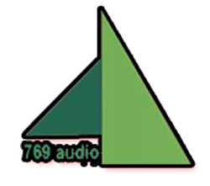
1st ChatBot Version
3.
Testing and Improvement
Performance Evaluation
After conducting 68 chat sessions that included chat history:
Precision: 1.00
Recall: 0.5735
F1-score: 0.729
Confusion Matrix:
[[ 0 0]
[29 39]]

Slide 23
1st ChatBot Version
3.
Testing and Improvement
Observation:
Understanding the Premise / Roleplay: The bot failed to grasp the established premise, resulting in incorrect responses that did not align with the intended scenario.
Chat History Integration: There were shortcomings in how the bot followed the chat history, responding irrelevantly to previous conversations.
Semantic Accuracy: The bot often delivered semantically incorrect responses, leading to confusion among users.

Slide 24
2nd ChatBot Version - Major Adjustments
3.
Testing and Improvement
After persistent issues persisted through over 60 chat sessions, we realized:
Despite numerous prompt adjustments, no significant improvements were observed.
It turned out that the code configuration errors hindered the integration of the RAG system with our existing premises and chat history.

Slide 25
2nd ChatBot Version - Major Adjustments
3.
Testing and Improvement
Key Adjustments Made
Improved RAG Initialization: Enhanced the RAG, better configuration for input and output paraphrasing.
Optimized chunk size: Determined the optimal chunk size by calculating the average character count per sentence.
Incorporated Reinforcement Learning: Implemented user feedback on each incorrect response during testing for dynamic adjustments.

Slide 26
2nd ChatBot Version - Major Adjustments
3.
Testing and Improvement
Performance Evaluation
After implementing these changes, we conducted 189 chat sessions that included chat history:
Precision: 1.00
Recall: 0.8377
F1-score: 0.9117
Confusion Matrix:
[[ 0 0]
[ 31 160]]

Slide 27
2nd ChatBot Version - Major Adjustments
3.
Testing and Improvement
Observation: Identifying Areas for Further Improvements
Handling Complex Queries: The bot struggled with sophisticated queries that involved multiple entities.
Analyzing User Needs: The bot's performance in understanding and analyzing user needs was suboptimal.

Slide 28
2nd ChatBot Version - Major Adjustments
3.
Testing and Improvement
Observation: Identifying Areas for Further Improvements
Retrieval Limitations: The LangChain Retriever primarily extracted chunks based on keywords, resulting relevant information omission from other columns.
Keyword Recognition: The bot had trouble with uncommon keywords frequently used by users, which made it challenging to accurately retrieve the correct products.

Slide 29
3rd ChatBot Version – Retrieval Enhancements
3.
Testing and Improvement
Row: 658 - Loa JBL Control 25
Row: 658 - https://769audio.vn/san-pham/312/loa-jbl-control-25-chinh-hang.html
Row: 658 - 2650000.0
Row: 658 - thumb/400_400/2/upload/product/664225935743.jpg
Row: 658 - 1.0
Row: 658 - https://769audio.vn/upload/images/jbl%20control%2025%20(2) ...
Row: 667 - Loa jbl control 25 là một dòng loa treo tường sản xuất bởi hãng jbl...

Slide 30
3rd ChatBot Version – Retrieval Enhancements
3.
Testing and Improvement
Performance Evaluation
Testing was conducted on 201 chat sessions:
Precision: 1.00 Recall: 0.8873 F1-score: 0.9403 Confusion Matrix: [[ 0 0]
[ 23 181]]

Slide 31
3rd ChatBot Version – Retrieval Enhancements
3.
Testing and Improvement
Improvements:
Notably reduced incorrect responses, retrieved more needed product information.
Handled complex queries involving multiple products (comparisons, summarizations) more effectively.

Slide 32
3rd ChatBot Version – Retrieval Enhancements
3.
Testing and Improvement
Issues (mostly persisted from the 2nd version):
Keyword Recognition: Still struggled with database-prevalent keywords by users.
Minor False Responses: Minor inaccuracies still occurred, particularly when handling multiple intricate entities and requests.

Slide 33
Accomplishments
4.1
Achievements and Benefits
UNIT
04
Enhanced Accuracy: Across three versions of our project, we have seen a significant increase in the accuracy rate
User Engagement: Implementing a feedback mechanism has allowed our bot to better understand users' needs and context.
57%
89%
Optimized Retrieval Methodology: Transitioned from merely retrieving similar search chunks to extracting all relevant product rows in the database
=> Enabled our bot to handle more complex and detailed user queries with greater precision.

Slide 34

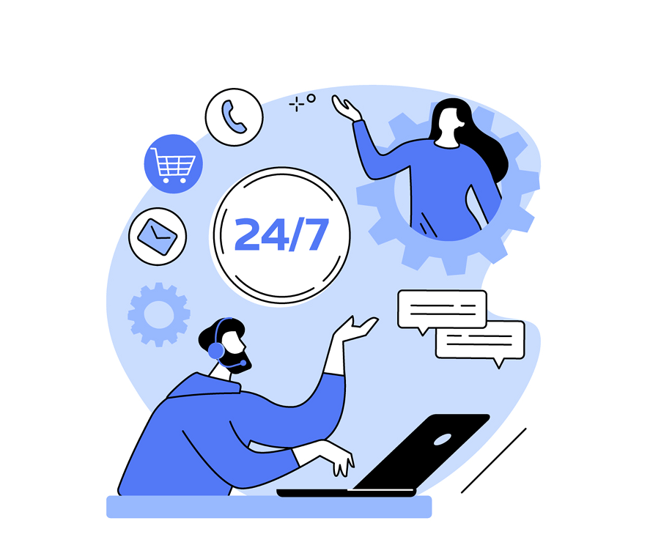
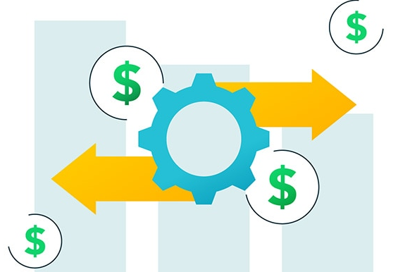
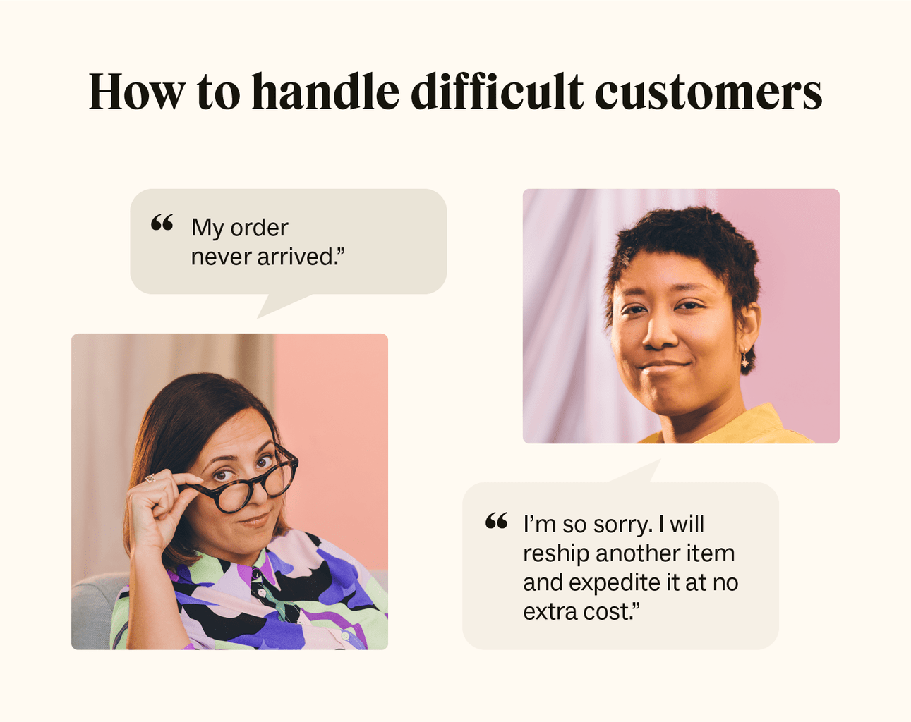


Benefits
4.1
Achievements and Benefits
UNIT
04
Cost Efficiency:
Reduces the need for extensive human customer service resources.
Allocate human to address more complex customer issues.
Reducing operational costs.
Market Competitiveness:
Improved customer satisfaction.
Attracting both new customers and potential business partnerships.
Improved Customer Care Service:
Our system provides instant, 24/7 support
Enhancing the overall user experience.
Save time.
Customers who may be reluctant to engage directly with sellers.

Slide 35
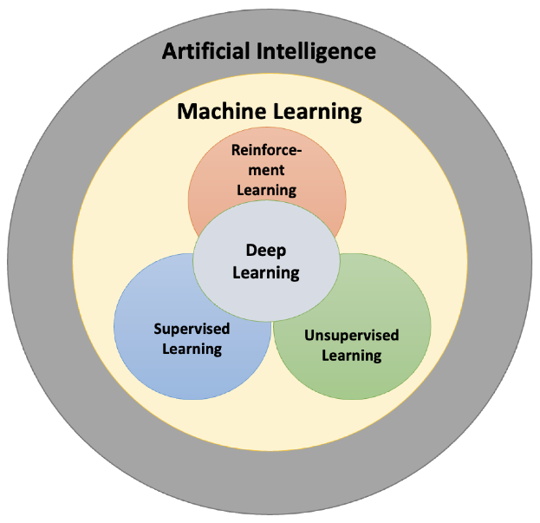
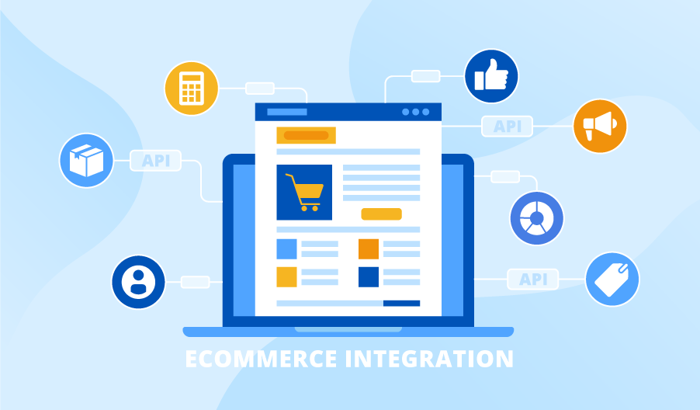
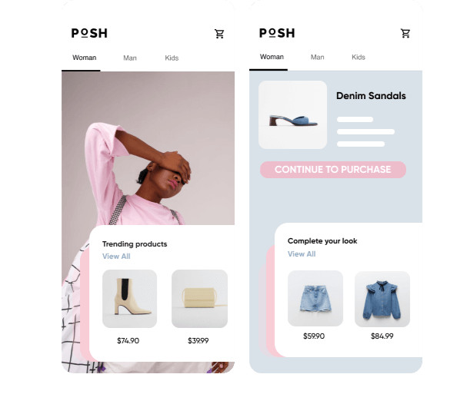
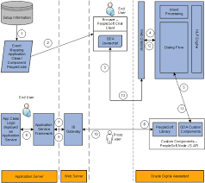
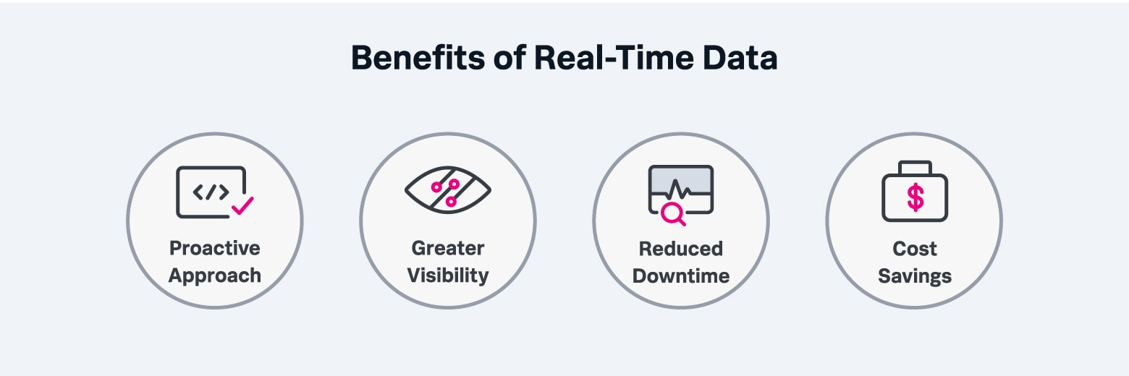

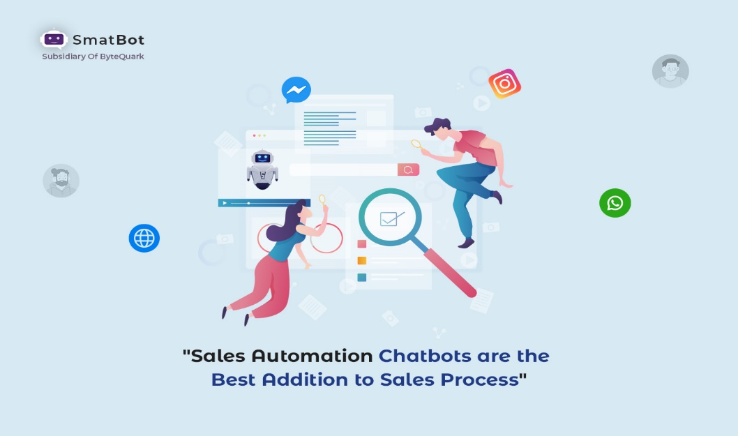
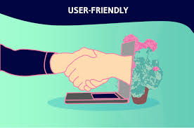
Improvements
4.2
Future Improvements
UNIT
04
Integration with Company Website
Reinforcement Learning for Keyword Optimization
Product Recommendations Using Association Rules
Real-time Data Update
Sales Pipeline Enhancement

Slide 36
THANK YOU FOR YOUR LISTENING
UNIT
04

